Slide 1
API Presentation openair
SMU Datascience – Livesession 9
Nagesh Padiyar
5/30/2017

Slide 2
Openair API
install.packages('openair')
library(openair)
openair has two functions for importing data from UK air pollution monitoring sites – importAURN and importKCL
We will use importKCL for check out how it works. We will also change a few parameters to see understand the function.

Slide 3
importKCL API : 2005 through 2010
> bloomsbury <- importKCL(site="bi0", year = 2005:2010)
BI0_2006 does not exist - ignoring that one.
BI0_2010 does not exist - ignoring that one.
NOTE - mass units are used
ug/m3 for NOx, NO2, SO2, O3; mg/m3 for CO
PM10_raw is raw data multiplied by 1.3
Warning messages:
1: In load(con) :
cannot open URL 'http://www.londonair.org.uk/r_data/BI0_2006.RData': HTTP status was '404 Not Found'
2: In load(con) :
cannot open URL 'http://www.londonair.org.uk/r_data/BI0_2010.RData': HTTP status was '404 Not Found'

Slide 4
importKCL API: Changing parameters for years
> bloomsbury <- importKCL(site="bi0", year = 2007:2009)
NOTE - mass units are used
ug/m3 for NOx, NO2, SO2, O3; mg/m3 for CO
PM10_raw is raw data multiplied by 1.3

Slide 5
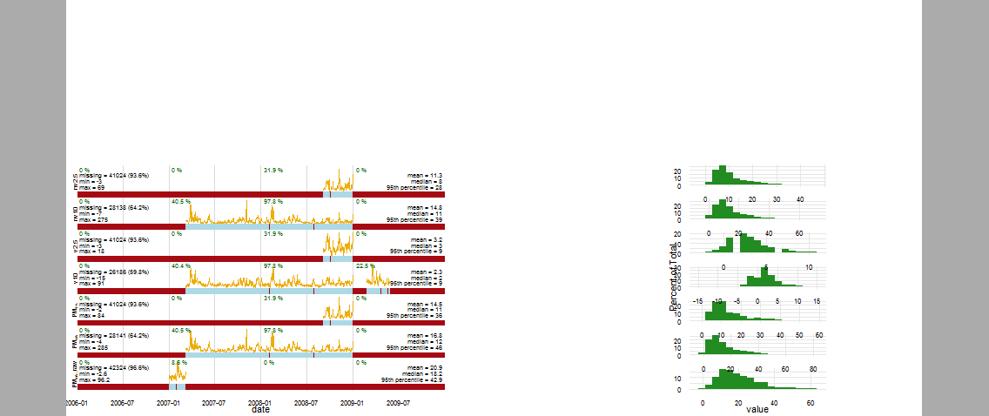
summaryPlot (bloomsbury)

Slide 6
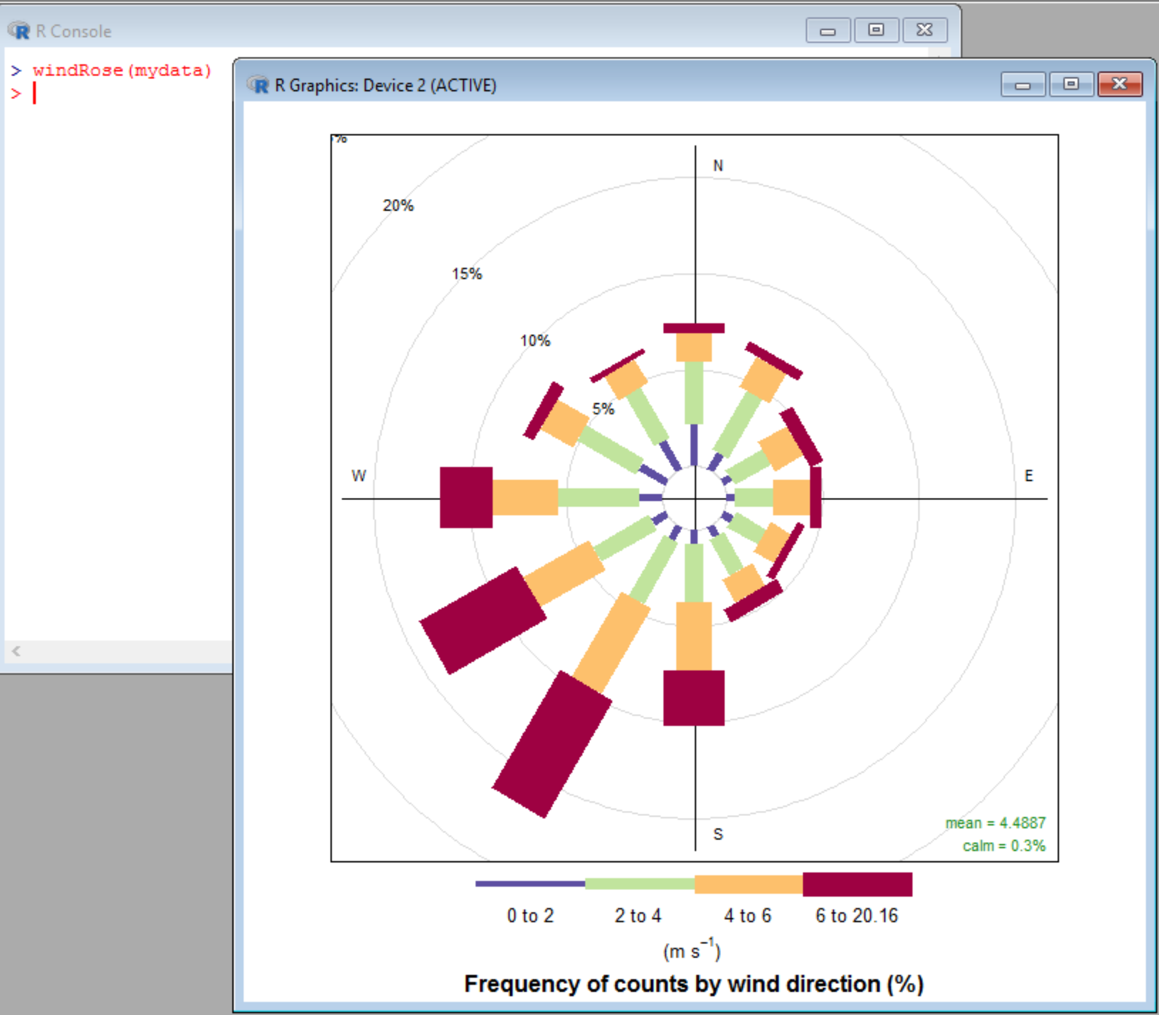
windRose(mydata)
Notes:
The basic plot of windRose.

Slide 7
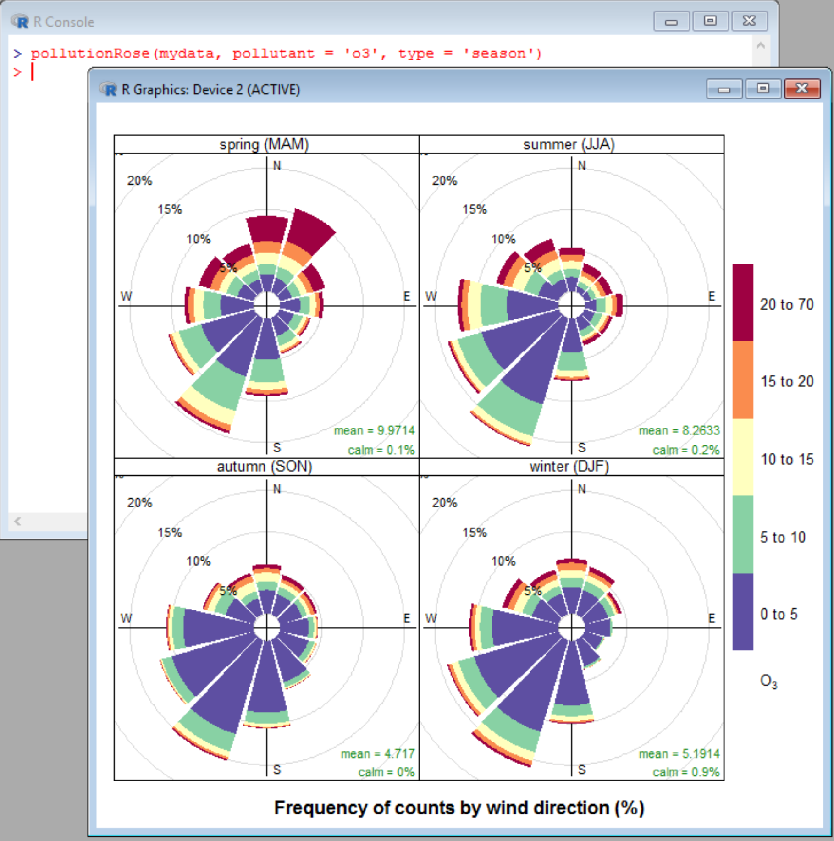
pollutionRose – For o3
Notes:
The highest concentration of ozone occurs in spring, when the wind is from the north.

Slide 8
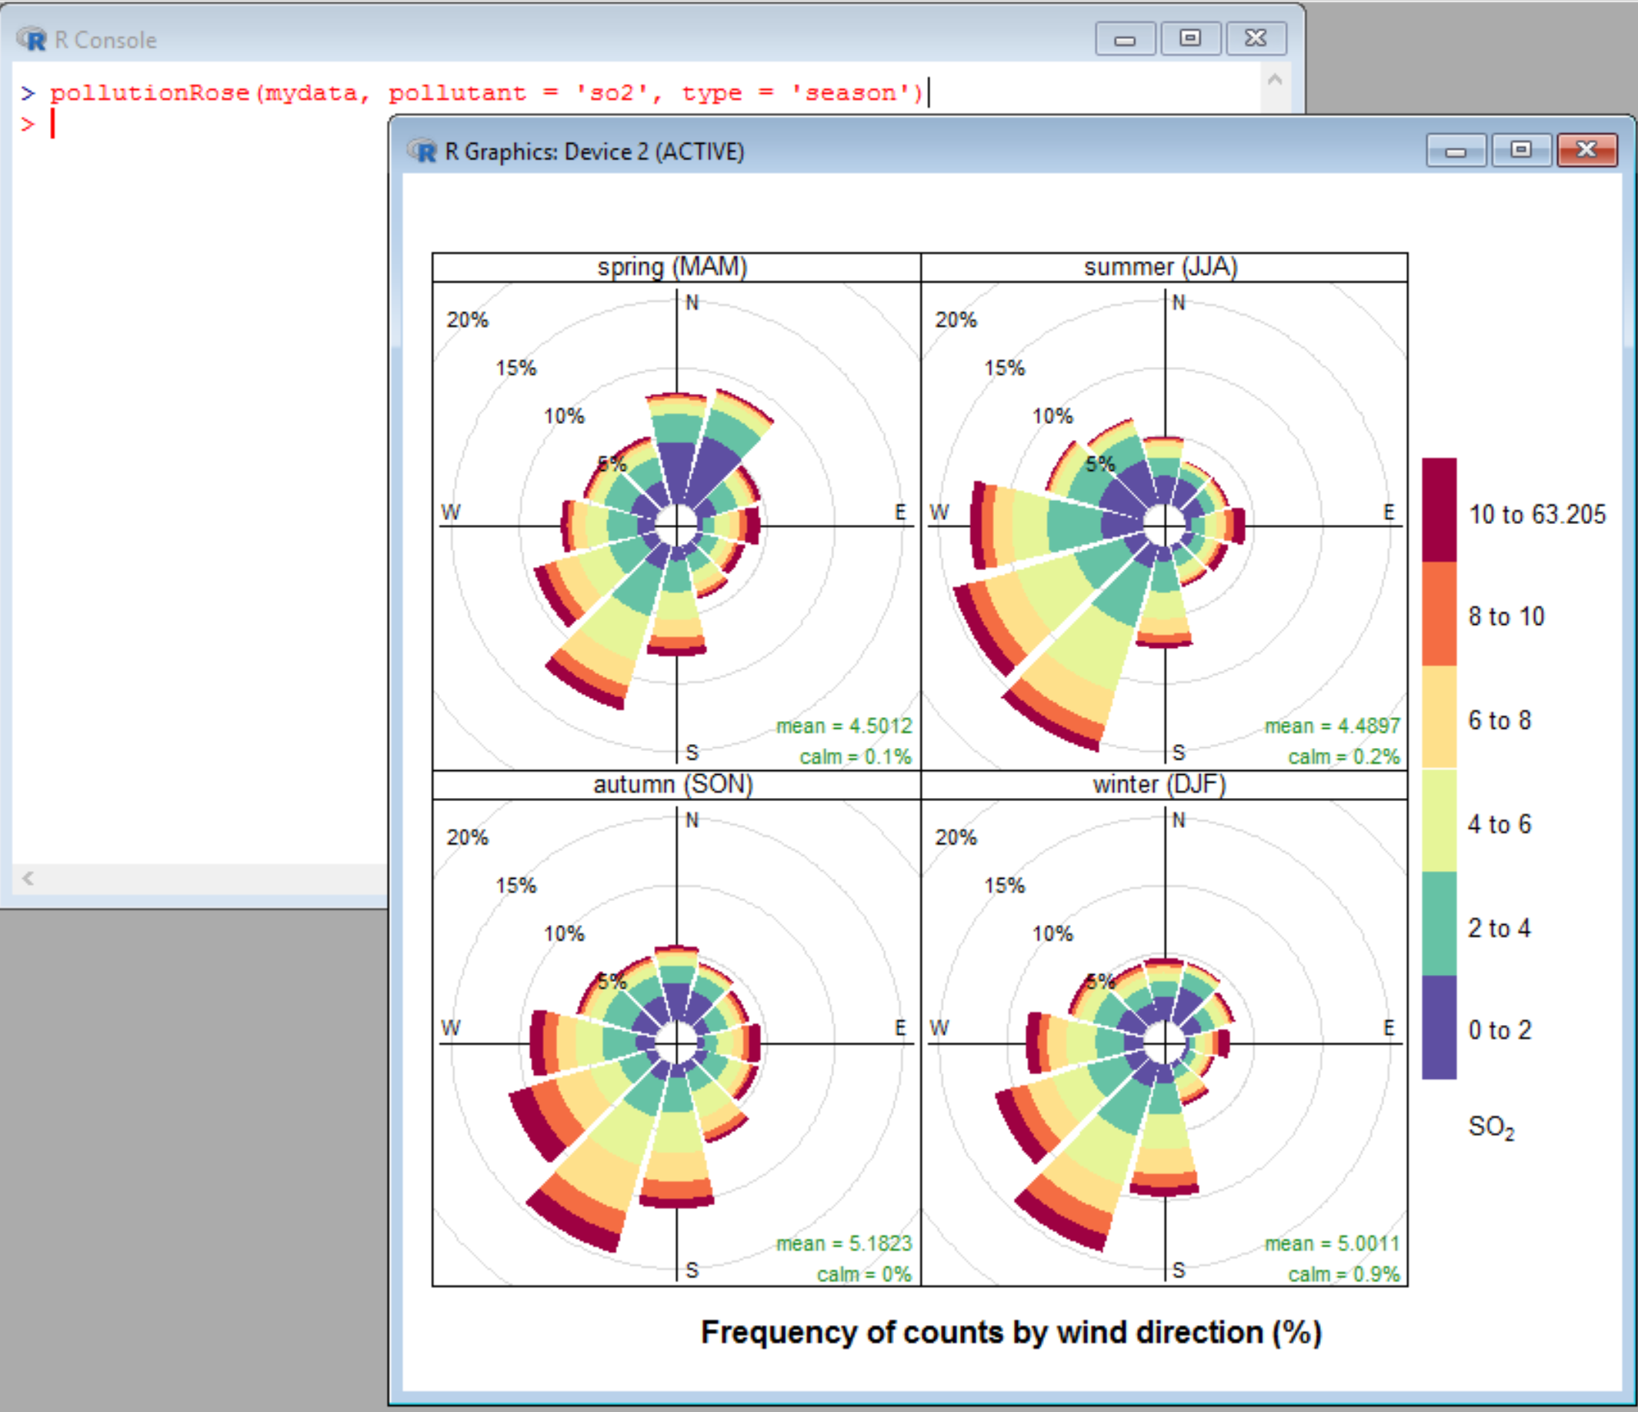
pollutionRose – for so2
Notes:
The highest so2 concentrations occur in Summer, when the wind is from the southwest.

Slide 9
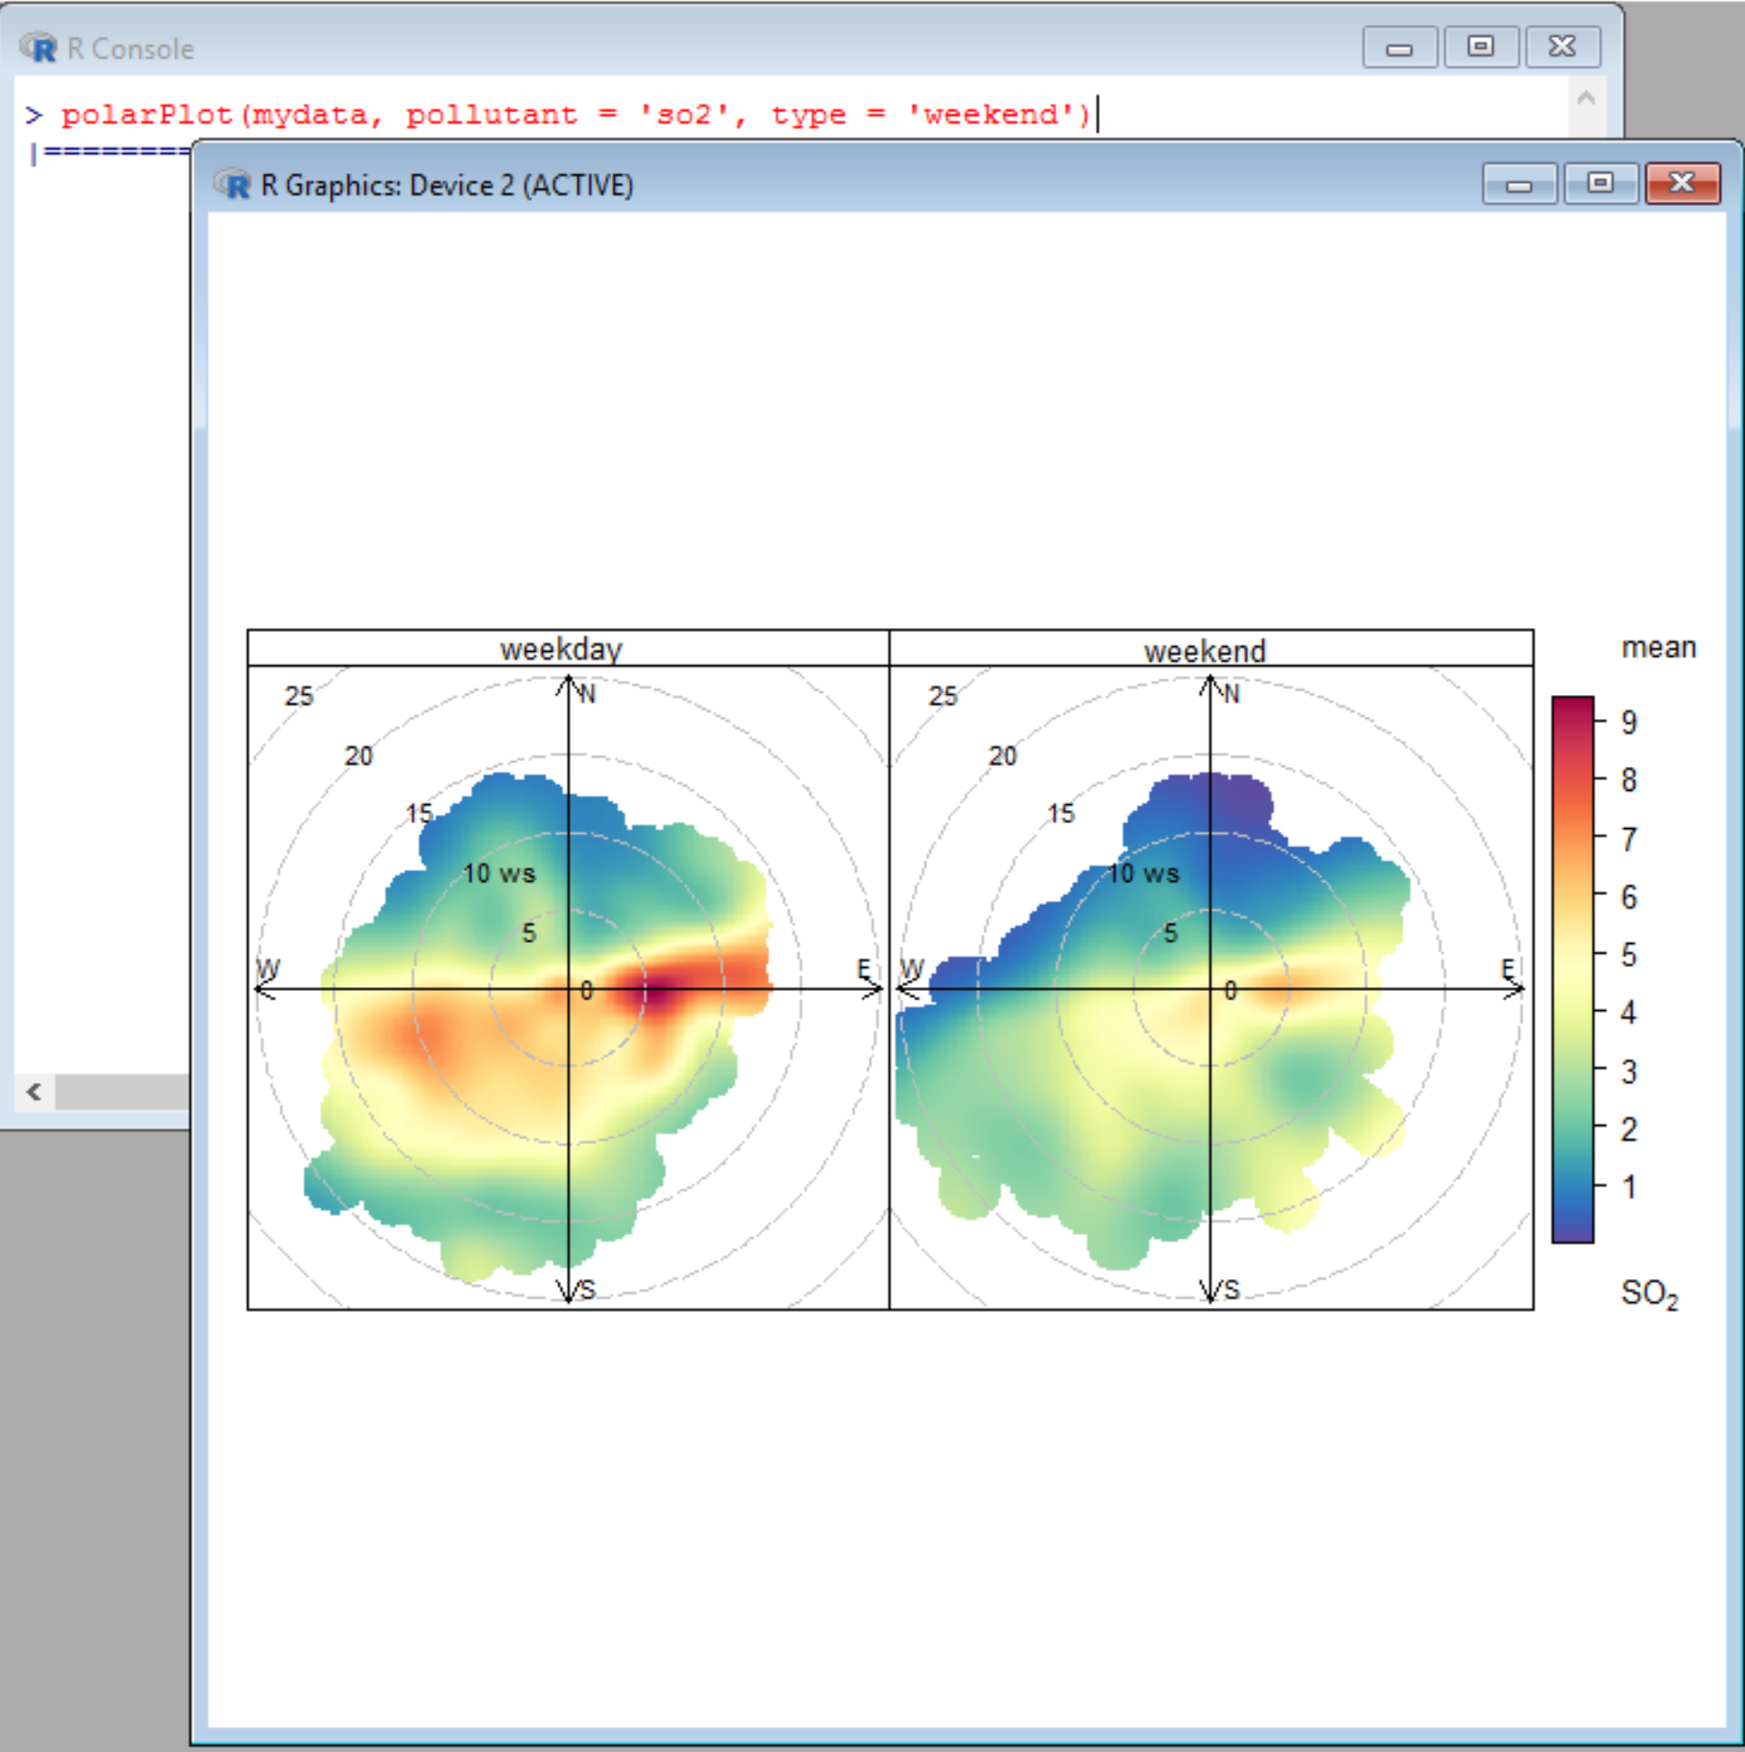
polarPlot – by using type = weekend
Notes:
polarPlot for so2 – Sulphur Dioxide

Slide 10
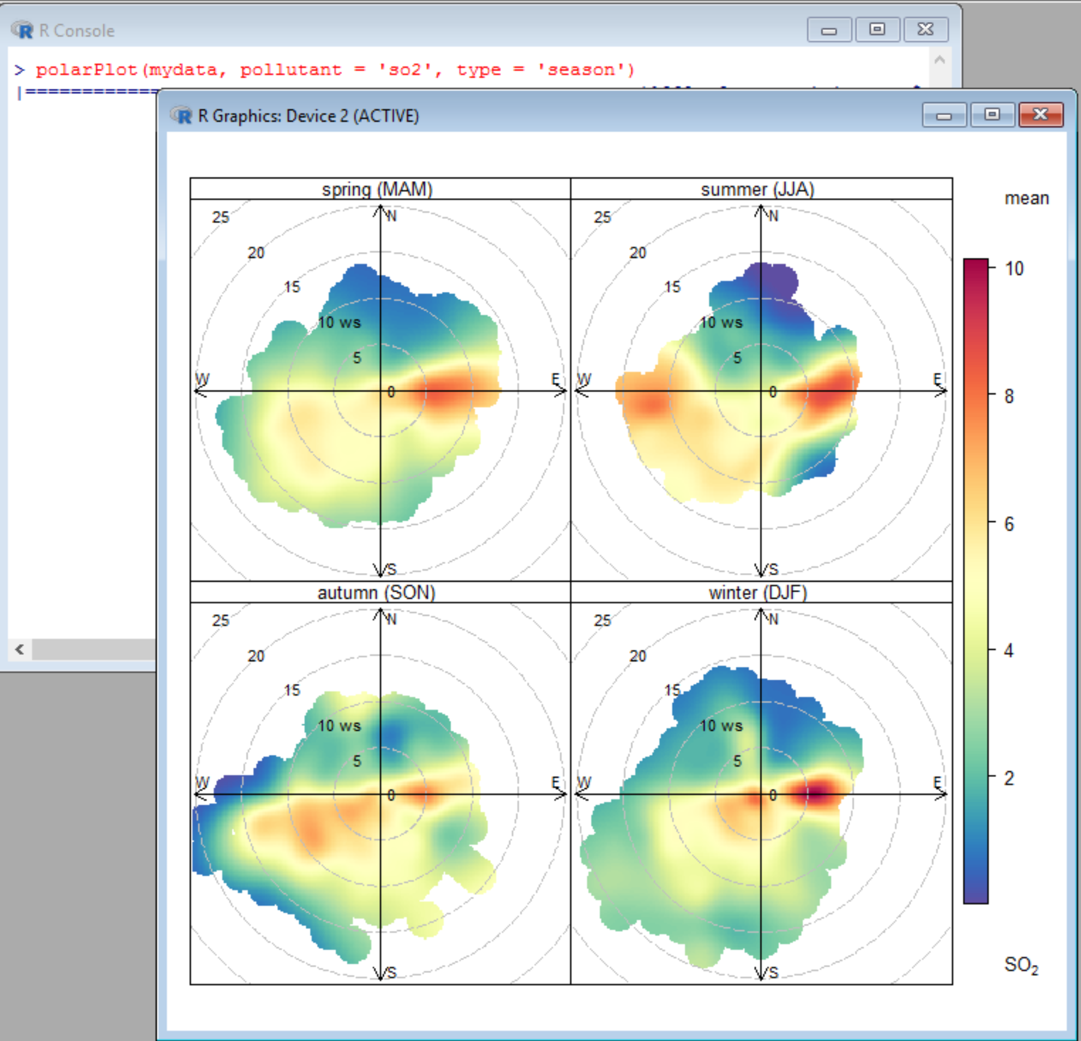
polarPlot – By using parameter type = Season
Notes:
polarPlot using type = season

